Slide 1
Scaling SharePoint: Meeting the Demands of Exponential Growth
Emily Mancini
Derek Cash-Peterson

Slide 2





Emily Mancini
Architect
Information Architect, Customer Experience Evangelist, & UX Specialist
Formerly an Office 365 Platform Owner and Trainer
emilymancini.com
linkedin.com/in/eemancini
@eemancini

Slide 3


Derek Cash-Peterson
Principal Architect
Professional developer since 1999
Working with SharePoint since 2006
https://spdcp.com
linkedin.com/in/derek-cash-peterson-6320752 ​
@spdcp
https://github.com/dcashpeterson/Public-Samples

Slide 4


Slide 5
Agenda
Generate demand
Identify toe hold
Customer experience
Inclusive environment
Manage demand
Governance
Self-Service
Align with business
Scale demand
Steering Committee
Strategic Plan

Slide 6


Slide 7
Generate demand by focusing on:
Which tools are best for the organization
Integration in Office 365
Productivity training

Slide 8


Slide 9
Create a seamless customer experience by focusing on:
Consistency across touchpoints
Building relationships

Slide 10


Slide 11
Create an inclusive space by focusing on:
Generating buzz
Consistency of user experience
Branding

Slide 12


Slide 13


Slide 14
Create a governance plan by focusing on:
Asking lots of questions first
Socializing governance with site owners
Implementing auditing

Slide 15
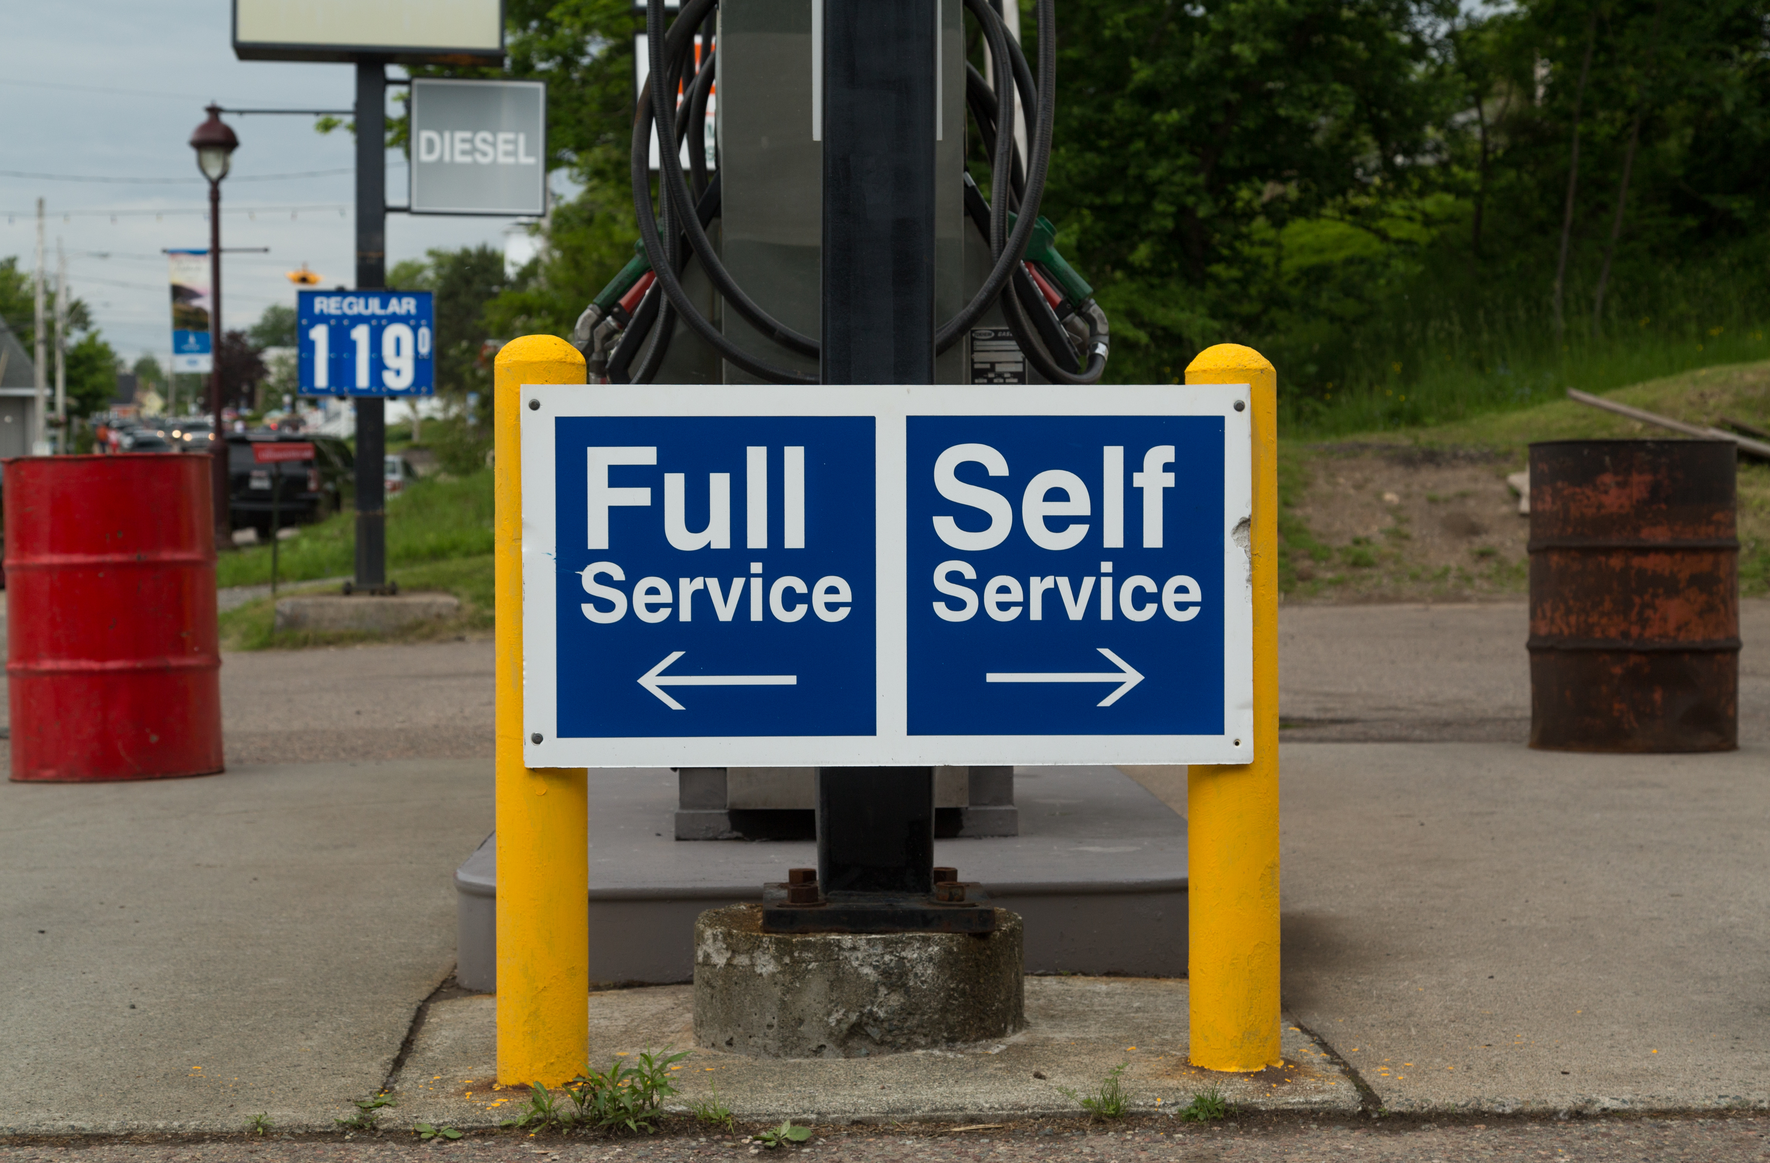

Slide 16
Launch self-service by focusing on:
Identifying champions
Partnering in site development
Bob German & Marc Anderson’s session, SharePoint Site Designs: Vision and Reality
Creating long-term support
Sue Hanley’s session, How to Create a Governance and Training Delivery Site for SharePoint and Office 365

Slide 17


Slide 18
Support self-service by focusing on:
Aligning goals with the business
Communicating expectations to leaders
Celebrating Site Owners’ successes

Slide 19


Slide 20
Establish a steering committee by focusing on:
Increasing visibility into Office 365 metrics and project queue
Aligning Office 365 needs with business and culture goals
Highlighting risk of keeping status quo

Slide 21
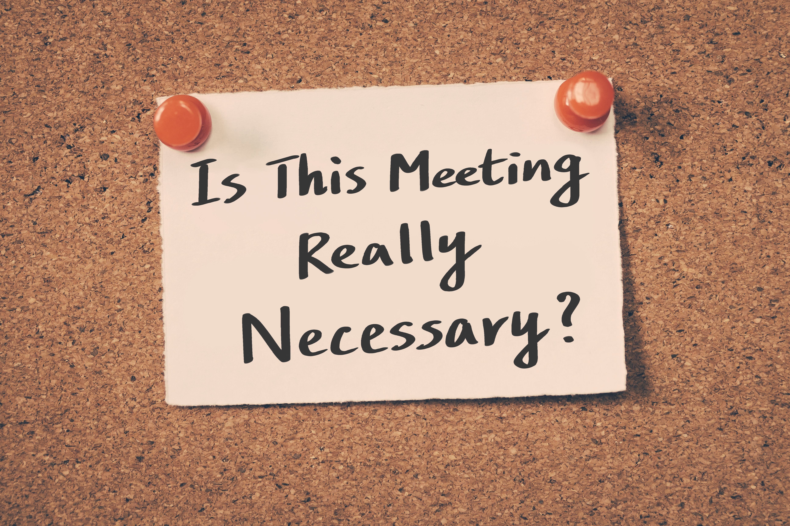

Slide 22
Run an effective steering committee by focusing on:
Routine project prioritization & communication
Align requests with company goals
Create visibility for company into project queue

Slide 23


Slide 24
Establish a strategic plan by focusing on:
Informal conversations
Department-level goals
Enterprise-level solutions

Slide 25
Time for Q&A…

Slide 26
Resources
Sessions Today:
Bob German & Marc Anderson, SharePoint Site Designs: Vision and Reality
Sue Hanley, How to Create a Governance and Training Delivery Site for SharePoint and Office 365
Online Resources:
Nielsen Normal Group Articles: on Customer Experience and Organizational Fluidity:
Good Customer Experience Demands Organizational Fluidity
User Experience vs. Customer Experience: What's the Difference?
Sue Hanley’s SharePoint and Office 365 Governance Policies and Guidelines Questions

Slide 27
THANK YOU!

Slide 28












Thanks to our Sponsors

